Slide 1
Parameters in RMI

Slide 2
Java Object Serialization
To serialize an object means to convert its state to a byte stream so that the byte stream can be reverted back into a copy of the object.
A Java object is serializable if its class or any of its superclasses implements either the java.io.Serializable interface or its subinterface, java.io.Externalizable.
Deserialization is the process of converting the serialized form of an object back into a copy of the object.

Slide 3
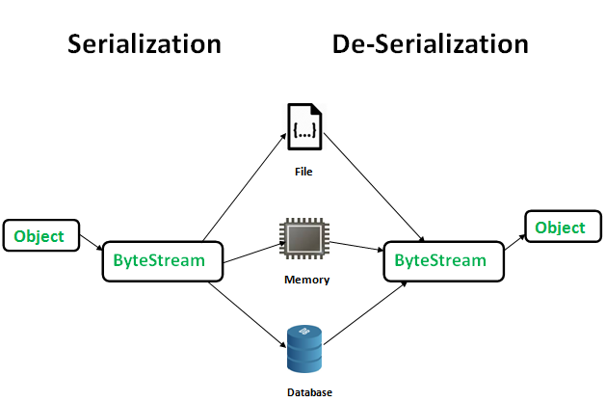
Serialization is a mechanism of converting the state of an object into a byte stream.
Deserialization is the reverse process where the byte stream is used to recreate the actual Java object in memory.
This mechanism is used to persist the object.

Slide 4
Java Object Serialization
The byte stream created is platform independent.
So, the object serialized on one platform can be deserialized on a different platform.
To make a Java object serializable we implement the java.io.Serializable interface.
The ObjectOutputStream class contains writeObject() method for serializing an Object.
public final void writeObject(Object obj) throws IOException
The ObjectInputStream class contains readObject() method for deserializing an object.
public final Object readObject() throws IOException, ClassNotFoundException

Slide 5
What is a serializable object?
Any object, including primitive types, remote objects and non-remote objects, that implements the java.io.Serializable interface is considered a serializable object.
What is the serializable interface?
The java.io.Serializable interface like java.rmi.Remote interface acts as a mark (it has no methods or fields) to tell the system such class or object is going to be downloaded to or travel on the network.
All subtypes of a serializable class are themselves serializable.
The types we have dealt with in the previous programs are String, double, and int.
Those types by default have been serialized.

Slide 6
How to find out a class has been serialized?
Check with Java API.
Note that if the class itself or its super class implements the java.io.Serializable interface, that class has been serialized and it is safe to use in your RMI program.
But, any class you defined should be serialized if you want to use it in network communication.
For example, you have a class Account like the below:

Slide 7
public class Account {
private String name;
private int AccountNumber; private double balance; .... }
And you have some methods in your remote class like:
private Account getAccount() throws RemoteException { return this.account; } or private void setAccount(Account acct) throws RemoteException { this.account = acct; }
In order to make your RMI program workable, you must make your class implement java.io.Serializalbe interface
public class Account implements java.io.Serializable{ private String name; private int AccountNumber; private double balance; .... }

Slide 8
Parameters in RMI
An argument to, or a return value from, a remote object can be any object that is serializable.
This includes
primitive types,
remote objects, and
non-remote objects that implement the java.io.Serializableinterface

Slide 9
Parameters in RMI
primitive types:
When a primitive data type is passed as a parameter to a remote method, the RMI system passes it by value.
RMI will make a copy of a primitive data type and send it to the remote method. If a method returns a primitive data type, it is also returned to the calling JVM by value.
Values are passed between JVMs in a standard, machine-independent format.
This allows JVMs running on different platforms to communicate with each other reliably.

Slide 10
REMOTE OBJECT:
Pass-by-Reference
A client program can obtain a remote reference to a remote object, through the RMI registry program.
When a method returns a local reference to an exported remote object, RMI does not return that object.
It substitutes another object (remote proxy for that service), in the return stream.
When a reference is returned to the server, it is not converted into a local reference.
When the object from the server is returned, to the client the proxy object is substituted.

Slide 11
Example of how RMI calls can be used:
Return remote reference from server to client A
Send remote reference from client A to client B
Send remote reference from client B to sever
When AccountImpl object is returned to the Client A,Account proxy object is substituted.
After this subsequent method calls continue to send the reference 1st to client B then back to server.

Slide 12
CLIENT A
CLIENT B
RMI Parameter
Account
Account
RMI Parameter
RMI Parameter
SERVER
AccountImpl
Account

Slide 13
Non Remote Objects:
passed by value
uses Java Object Serialization
When an object is passed to a remote method, the semantics change from the case of the single JVM.
RMI sends the object itself, not its reference, between JVMs.
It is the object that is passed by value, not the reference to the object.
Similarly, when a remote method returns an object, a copy of the whole object is returned to the calling program.
Because different JVMs do not share heap memory, RMI must send the referenced object and all objects it reference.

Slide 14
RMI uses a technology called Object Serialization to transform an object into a linear format that can then be sent over the network wire.
Serialized objects can be de-serialized in the memory of the remote JVM and made ready for use by a Java program.

Slide 15
Parameters in Single JVM
Primitive Data Type
When received parameters JVM makes copy of it, and places it on stack and executes methods.
When code inside method uses a parameter, it accesses its stack and uses copy of the parameter.
Values returned from the methods are also copies.
When method receives parameters as primitive data type, it uses pass by value mechanism.

Slide 16
Parameters in Single JVM
Object as a parameter:
An object resides in heap memory and is accessed through one or more reference variables.
Eg. String str=“Test”;
System.out.Println(str);
It looks like object is passed to the method println(),it I the reference variable that is passed to the method.

